Slide 1
ToDo Application
PROJECT ONE

Slide 2
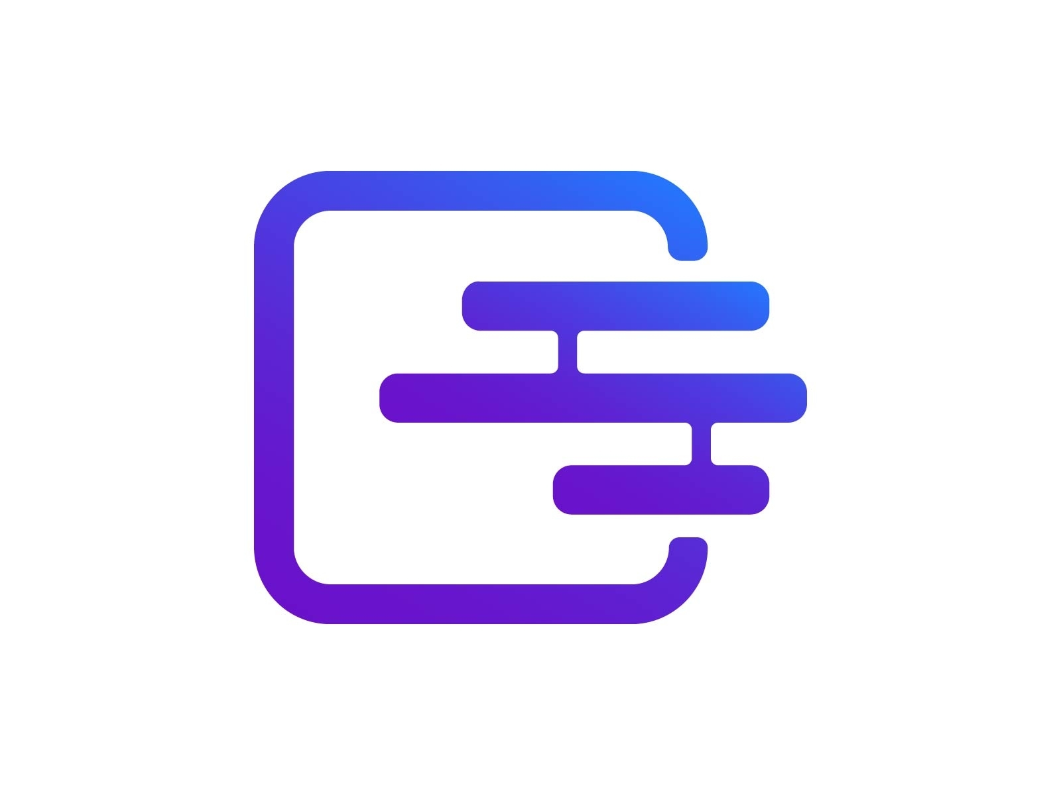

Slide 3
Project Aim
The main aim of this project is to design and implement a todo android application using room persistence library and other android architecture components.

Slide 4
Objectives
Create todo item
Update, delete and share todo item
Learn how to use SQLite implementation on android
Learn about Intents, Views and Activities
Share data across applications

Slide 5
Libraries
Room Persistence Library
Android Architecture Lifecycle Library
Kotlin Coroutines
Koin
Recyclerview, Cardview and Material Theming

Slide 6
Introduction
The purpose of Architecture components is to provide guidance on app architecture with libraries for common tasks like lifecycle management and data persistence.

Slide 7
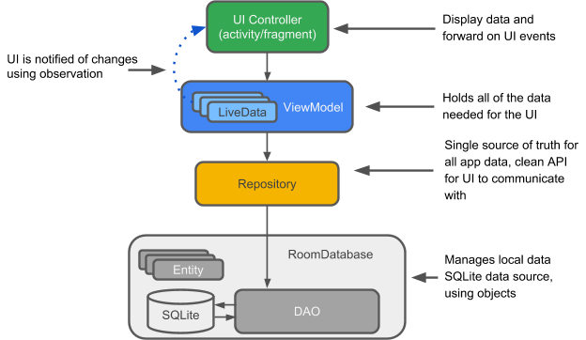
What are the recommended Architecture Components?

Slide 8
Components
Entity: This is an annotated class that describes a database table
SQLite Database: This is a database that is saved onto the device of the user. Room persistence library creates and maintains this database for you
Data Access Object(Dao): This interface contains methods that handle requests to the room database.
Room Database: Database holder that serves as an access point to the underlying SQLite database.

Slide 9
Components
Repository: Manages multiple data sources
ViewModel: Provides data for the UI
LiveData: A data holder class that can be observed

Slide 10
What you will be learning
In this project you build an app that does the following:
Works with a database to get and save the data, and pre-populates the database with some todo items.
Displays all the todo items in a recyclerview in the TodoActivity
Opens a second activity when the user taps the + button. When the user enters a todo item, adds the item to the database and the list.

